Slide 1


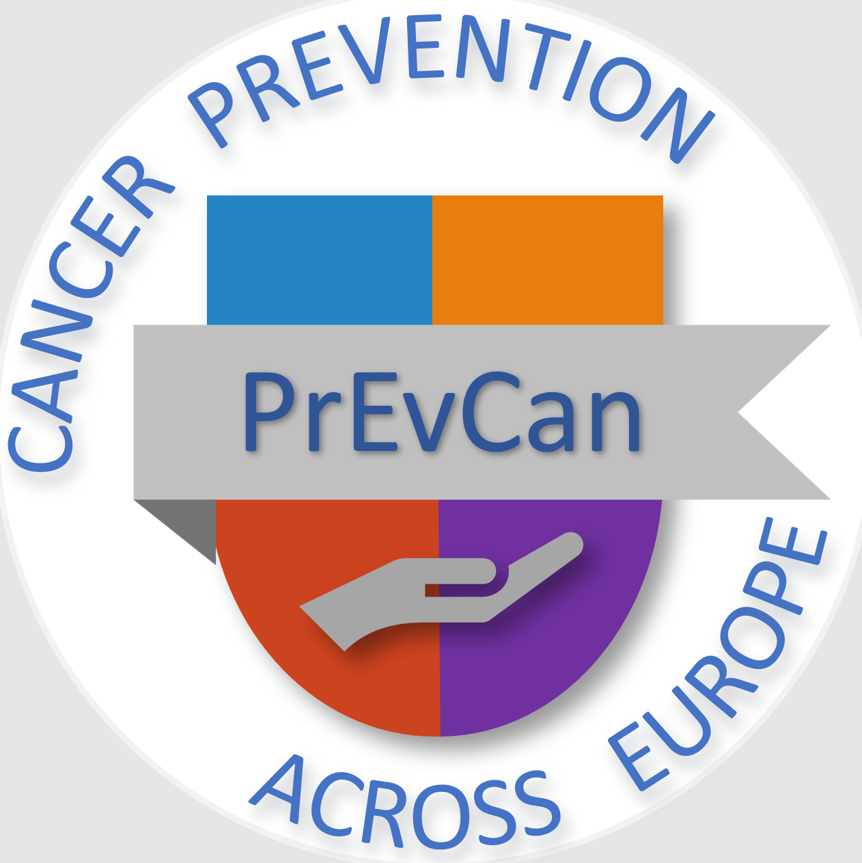

IN THE WORKPLACE PROTECT YOURSELF AGAINST
CANCER-CAUSING SUBSTANCES
C
Messages for healthcare professionals
#PrEvCan #CANCERCODE
The PrEvCan campaign was initiated by EONS and is run in association
with key campaign partner, ESMO. More info: www.cancernurse.eu/prevcan

Slide 2

Insert logo
of your organization
here
IN THE WORKPLACE PROTECT YOURSELF AGAINST
CANCER-CAUSING SUBSTANCES
C
Always provide
health related information
to patients & their significant others and encourage them
to take an active part
in their care
#PrEvCan #CANCERCODE
The PrEvCan campaign was initiated by EONS and is run in association
with key campaign partner, ESMO. More info: www.cancernurse.eu/prevcan

Slide 3

Insert logo
of your organization
here
IN THE WORKPLACE PROTECT YOURSELF AGAINST
CANCER-CAUSING SUBSTANCES
C
Avoid direct contact
with hazardous drugs
when planning pregnancy, during pregnancy
or breast feeding
#PrEvCan #CANCERCODE
The PrEvCan campaign was initiated by EONS and is run in association
with key campaign partner, ESMO. More info: www.cancernurse.eu/prevcan

Slide 4
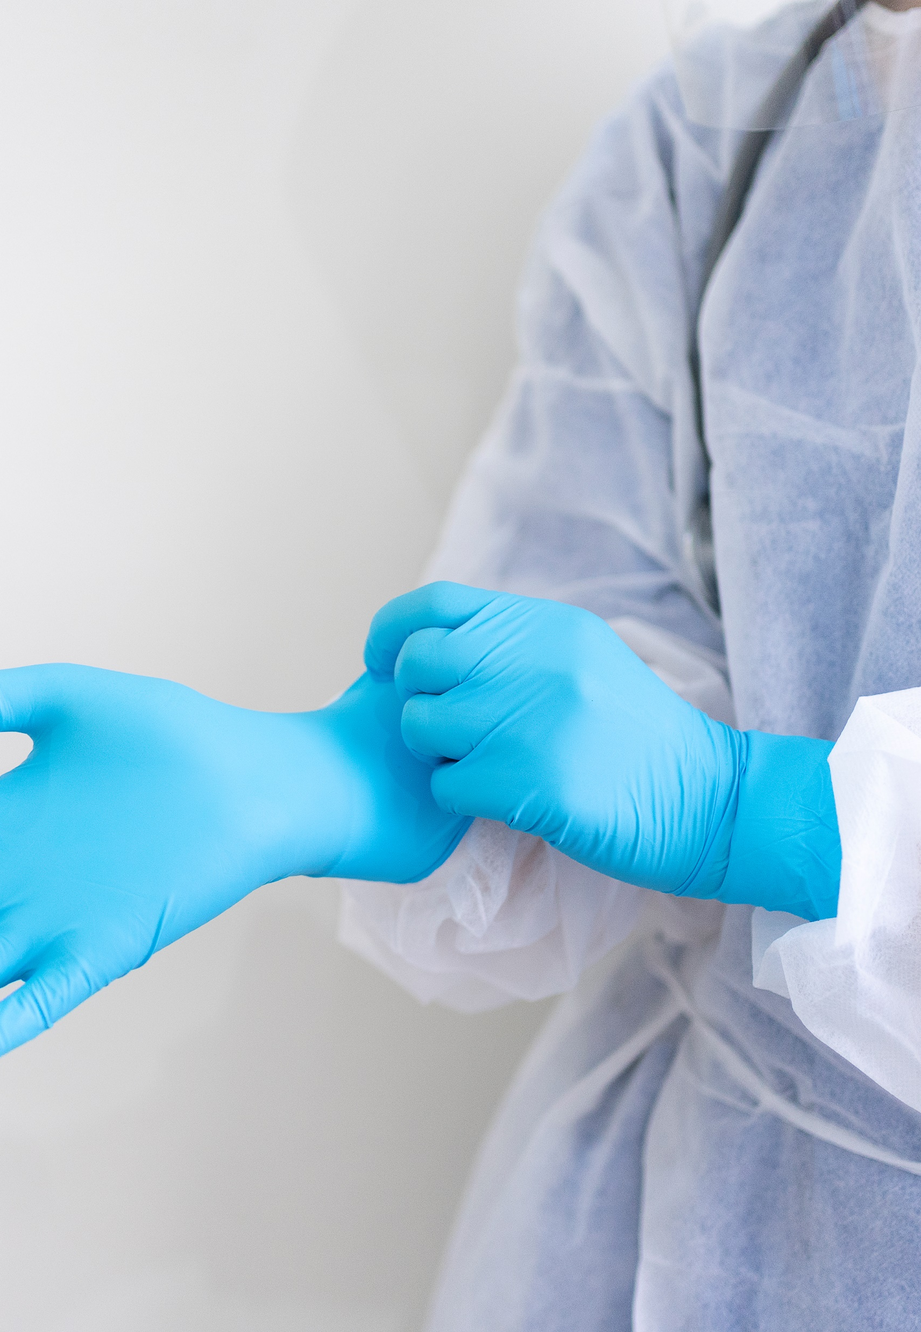
Insert logo
of your organization
here
IN THE WORKPLACE PROTECT YOURSELF AGAINST
CANCER-CAUSING SUBSTANCES
C
When handling
hazardous cancer drugs,
always follow
safety precautions;
use personal protective equipment.
#PrEvCan #CANCERCODE
The PrEvCan campaign was initiated by EONS and is run in association
with key campaign partner, ESMO. More info: www.cancernurse.eu/prevcan

Slide 5

Insert logo
of your organization
here
IN THE WORKPLACE PROTECT YOURSELF AGAINST
CANCER-CAUSING SUBSTANCES
C
Occupational safety
=
patient safety
#PrEvCan #CANCERCODE
The PrEvCan campaign was initiated by EONS and is run in association
with key campaign partner, ESMO. More info: www.cancernurse.eu/prevcan

Slide 6

Insert logo
of your organization
here
IN THE WORKPLACE PROTECT YOURSELF AGAINST
CANCER-CAUSING SUBSTANCES
C
Foster a safety culture
in your workplace
#PrEvCan #CANCERCODE
The PrEvCan campaign was initiated by EONS and is run in association
with key campaign partner, ESMO. More info: www.cancernurse.eu/prevcan

Slide 7

Insert logo
of your organization
here
IN THE WORKPLACE PROTECT YOURSELF AGAINST
CANCER-CAUSING SUBSTANCES
C
Always
speak up and question
if something is
or appears to be wrong
#PrEvCan #CANCERCODE
The PrEvCan campaign was initiated by EONS and is run in association
with key campaign partner, ESMO. More info: www.cancernurse.eu/prevcan

Slide 8

Insert logo
of your organization
here
IN THE WORKPLACE PROTECT YOURSELF AGAINST
CANCER-CAUSING SUBSTANCES
C
Thank colleagues
who raise concerns
related to safety
#PrEvCan #CANCERCODE
The PrEvCan campaign was initiated by EONS and is run in association
with key campaign partner, ESMO. More info: www.cancernurse.eu/prevcan

Slide 9

Insert logo
of your organization
here
IN THE WORKPLACE PROTECT YOURSELF AGAINST
CANCER-CAUSING SUBSTANCES
C
Paste your photo
Customized
message
#PrEvCan #CANCERCODE
The PrEvCan campaign was initiated by EONS and is run in association
with key campaign partner, ESMO. More info: www.cancernurse.eu/prevcan

